Slide 1

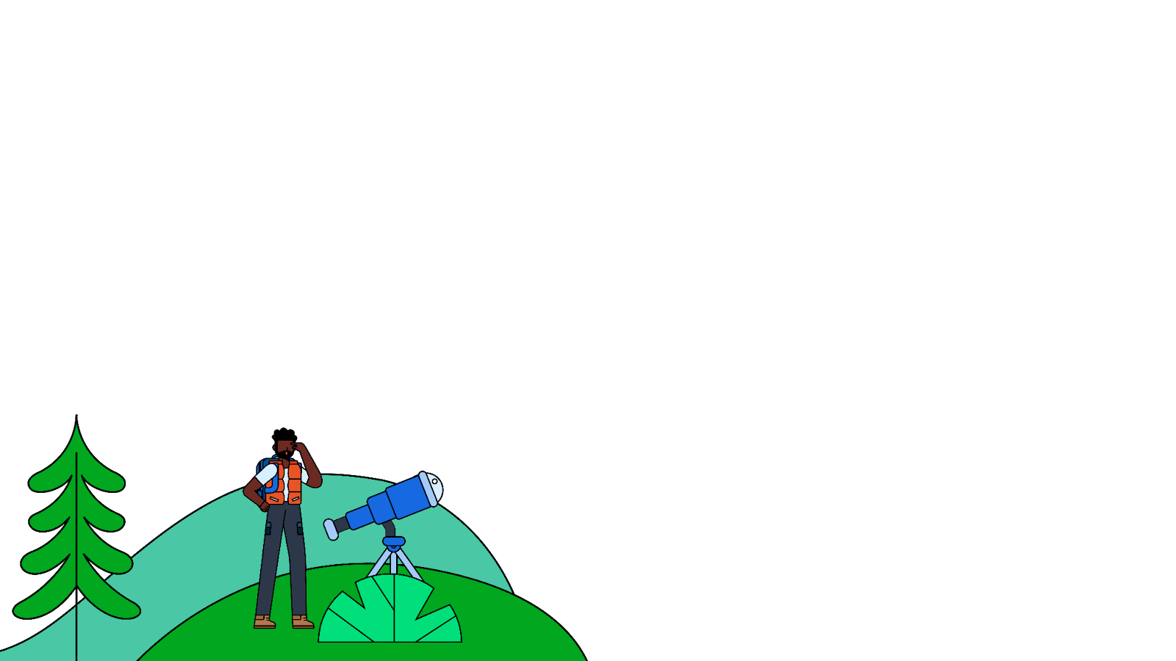

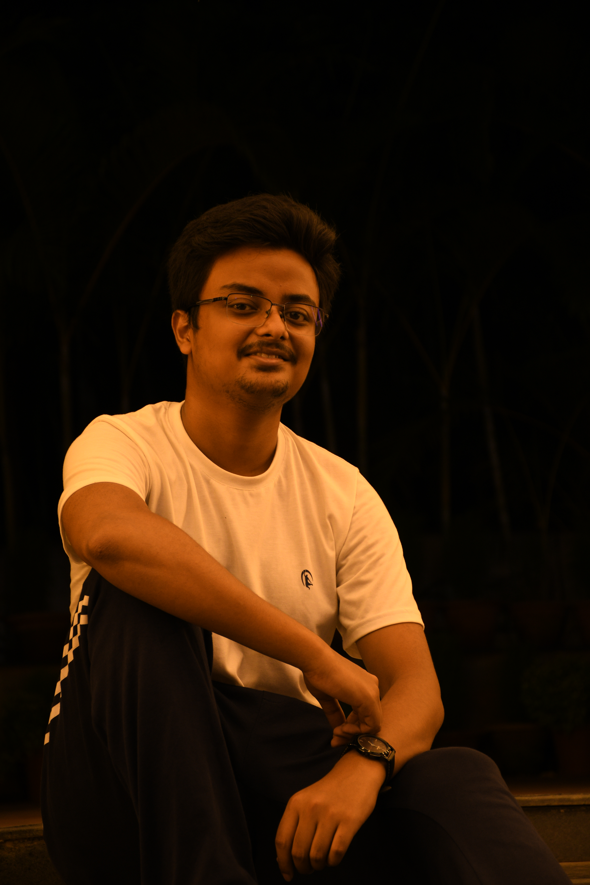
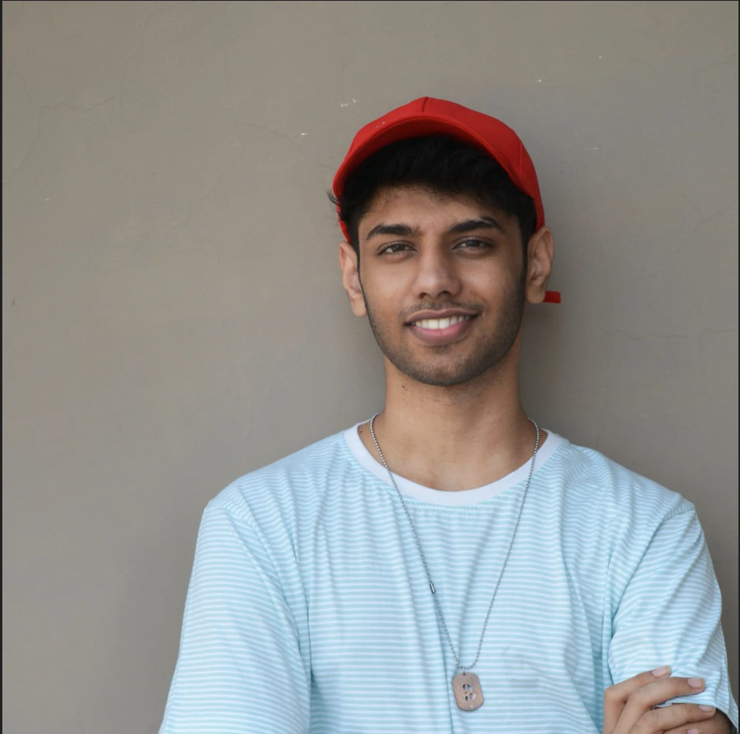
Welcome to
Compose Camp
Session 4 – App Architecture
Rungshit Saha
CodeFlyAir (@Github)

Slide 2
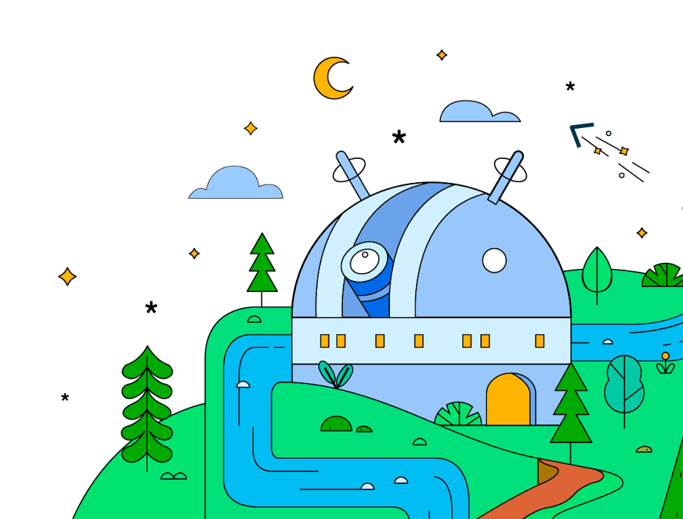
Today’s Objectives
1
Stages of Activity Life Cycle
2
App Architectural Layers
3
Implementation

Slide 3
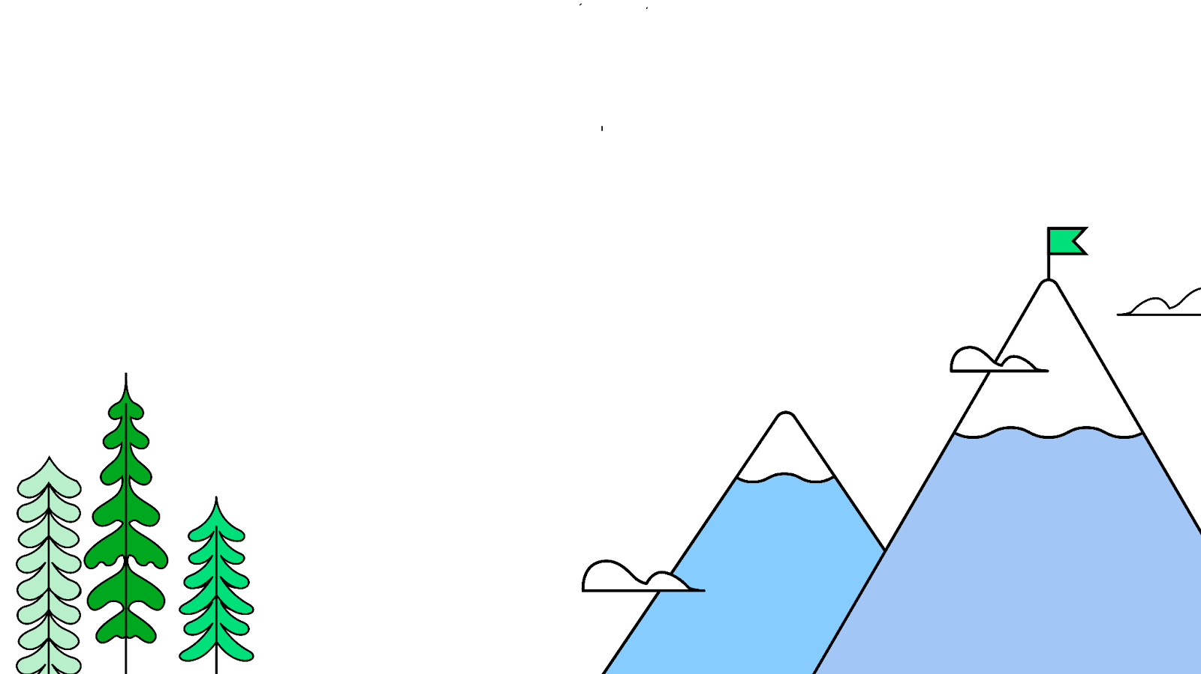

Let’s Get Started
This work is licensed under the Apache 2.0 License

Slide 4
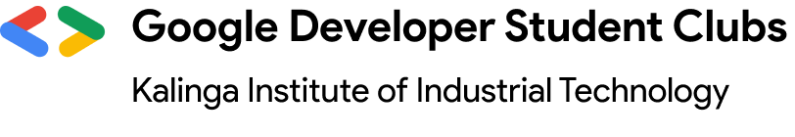
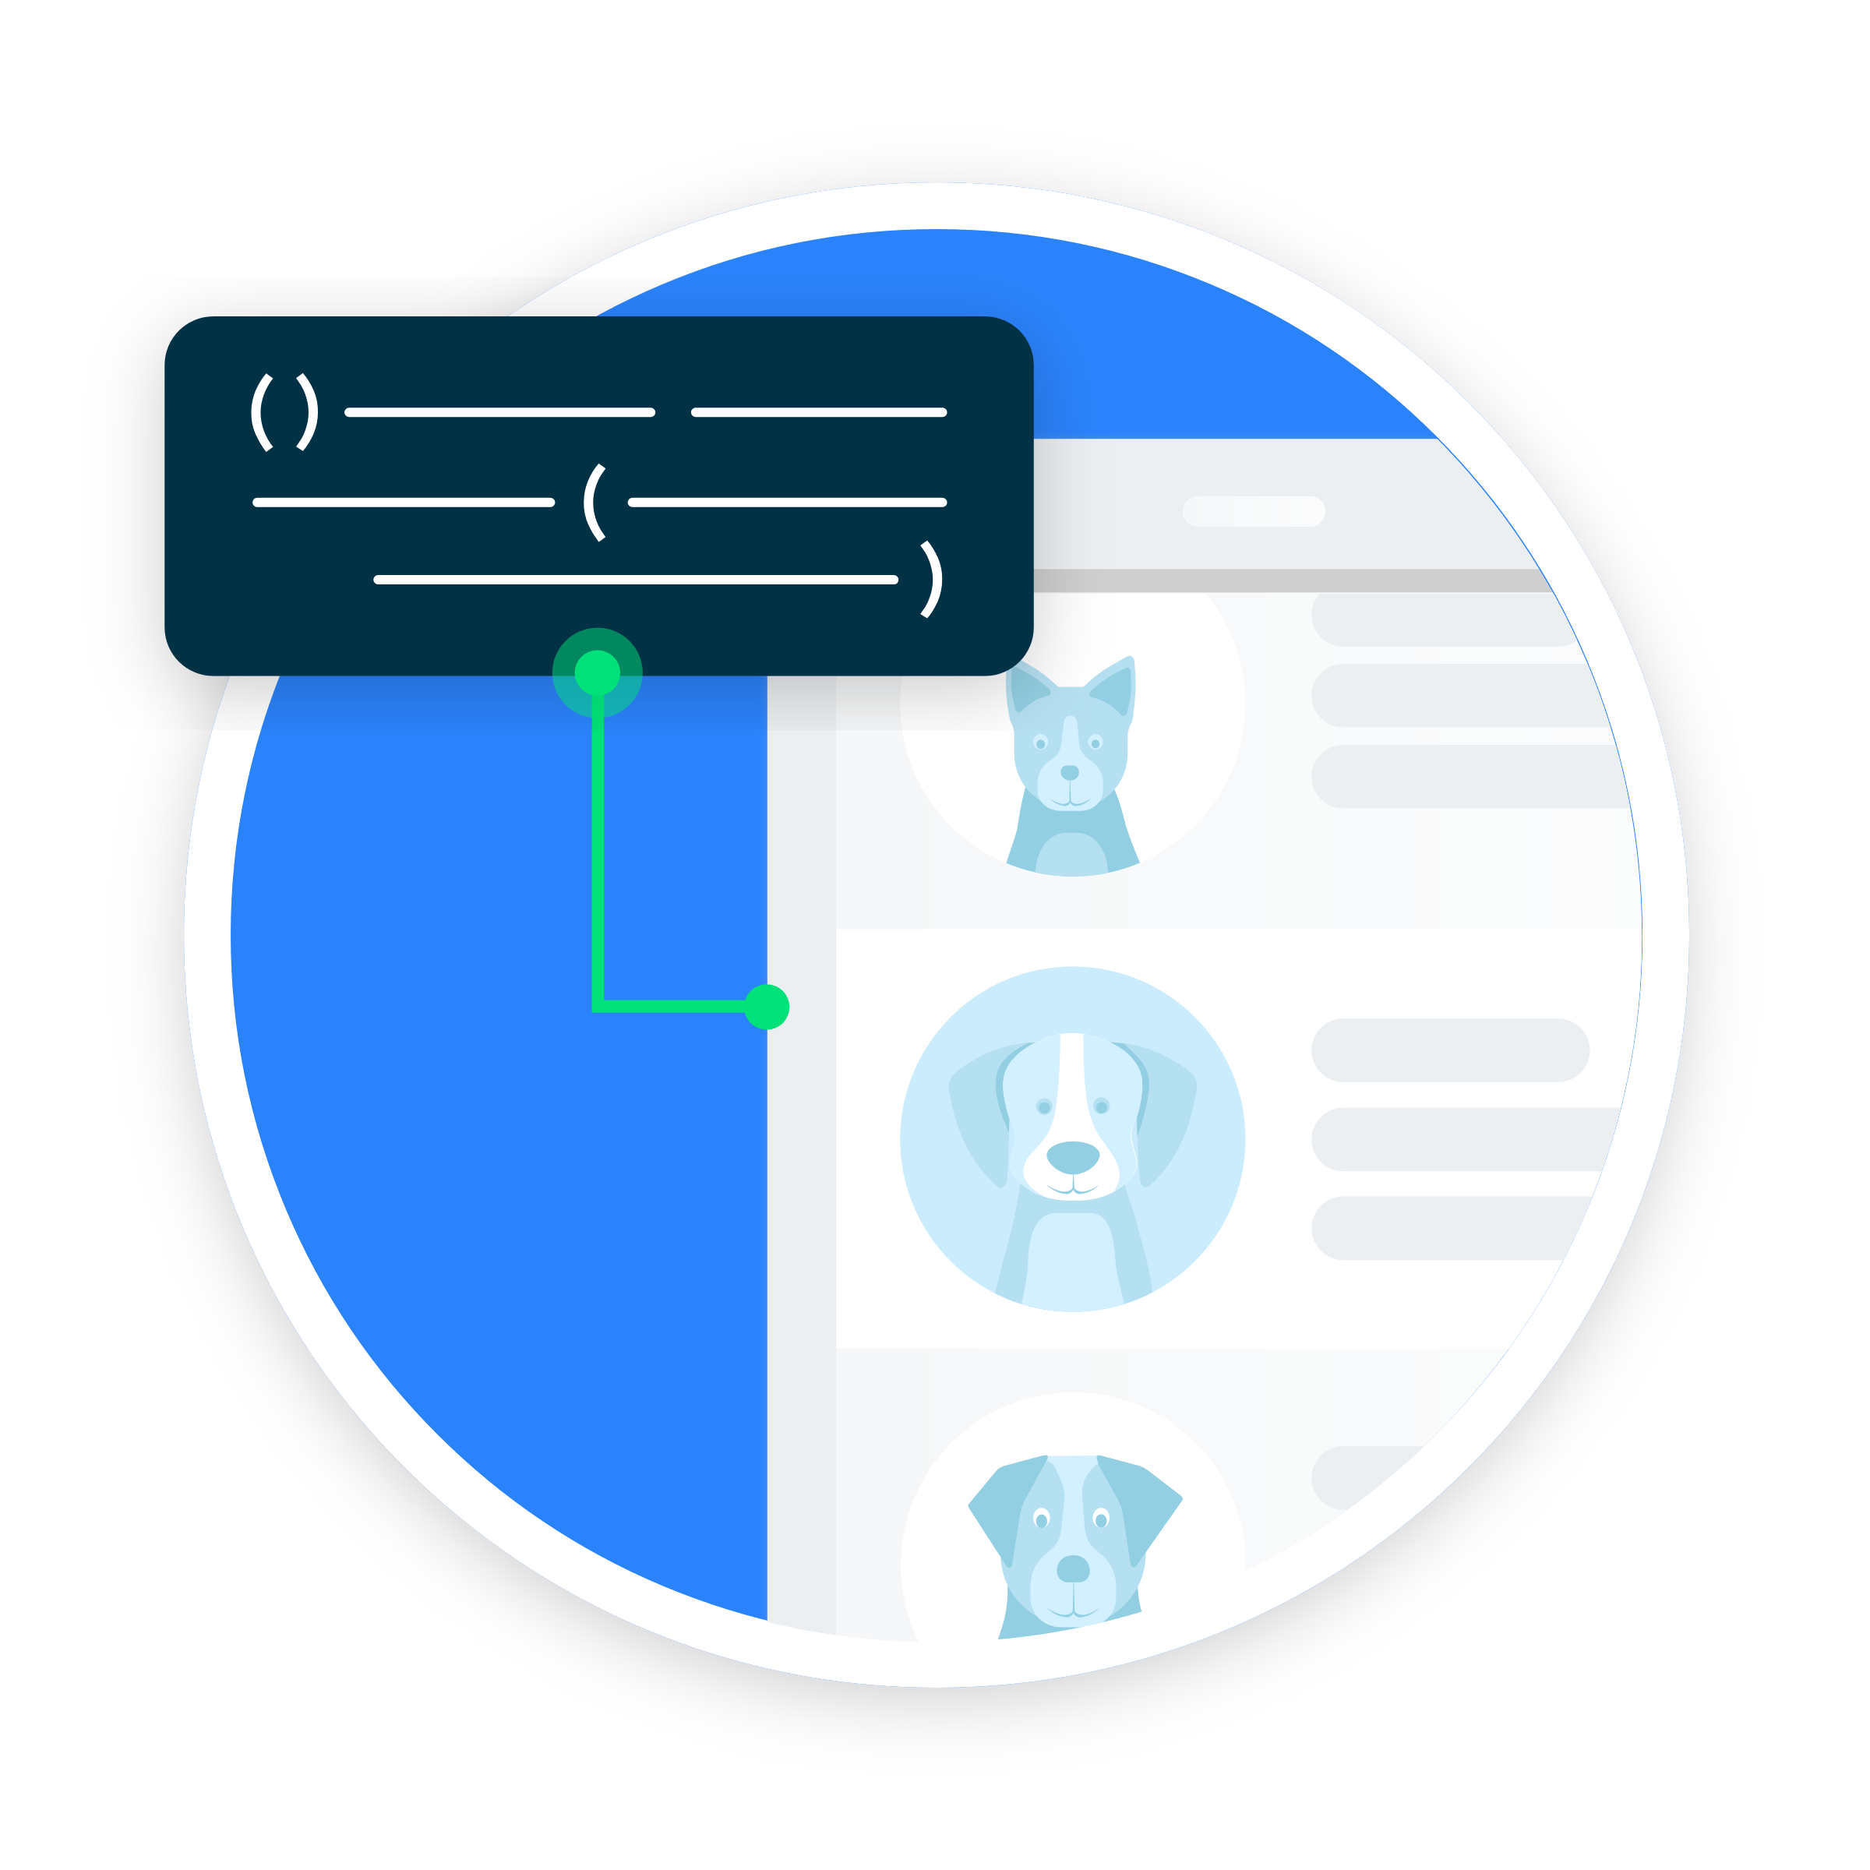
Stages of Activity LifeCycle
1

Slide 5
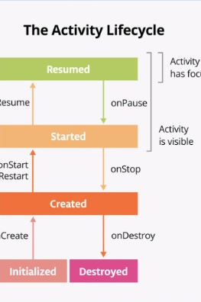

Activity LifeCycle
The Activity lifecycle consists of the different states that an activity can go through, from when the activity first initializes to its destruction. Android activities begin with the onCreate() method.

Slide 6
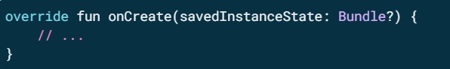
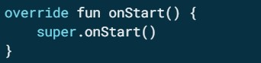
OnCreate() and OnStart() Implementation
onCreate() is the one method that every activity must implement. The onCreate() method is where you should do any one-time initializations for your activity. For example, in onCreate(), you call setContent(), which specifies the activity's UI layout.
The onStart() lifecycle method is called just after onCreate(). After onStart() runs, your activity is visible on the screen. Unlike onCreate(), which is called only once to initialize your activity, onStart()can be called by the system many times in the lifecycle of your activity.

Slide 7
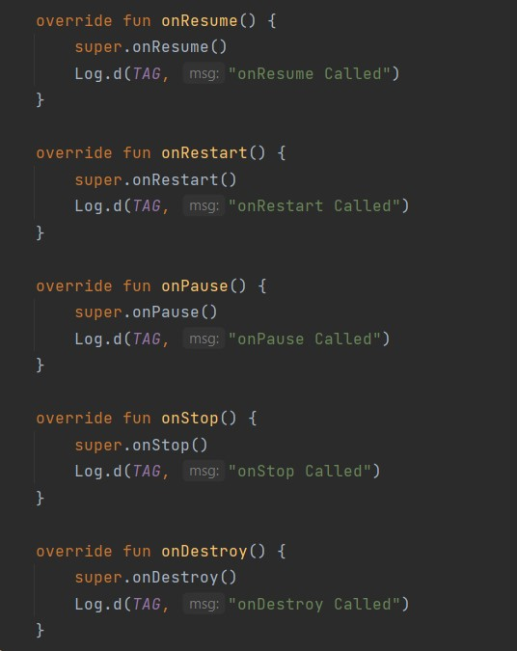
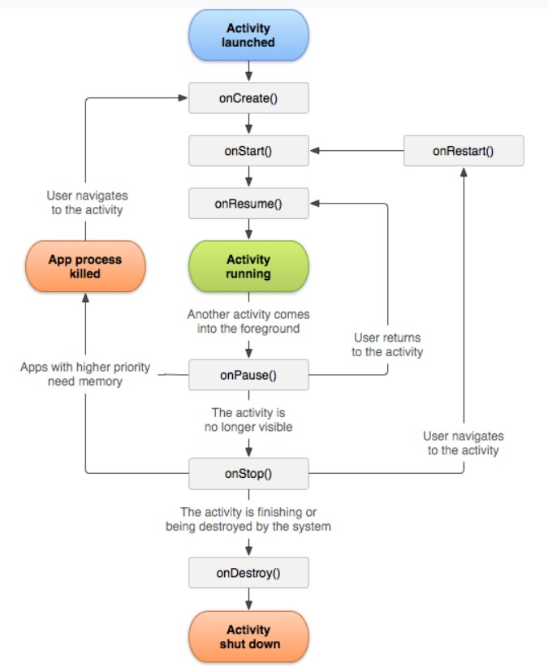
Other LifeCycle Use Cases

Slide 8

Lifecycle of a composable
In order for Compose to track and trigger a recomposition, it needs to know when state has changed. To indicate to Compose that it should track an object's state, the object needs to be of type State or MutableState.
The State type is immutable and can only be read. A MutableState type is mutable and allows reads and writes.

Slide 9
App Architecture
2

Slide 10
Well Architected Application
Test
Robust
Expand
Team Develop

Slide 11

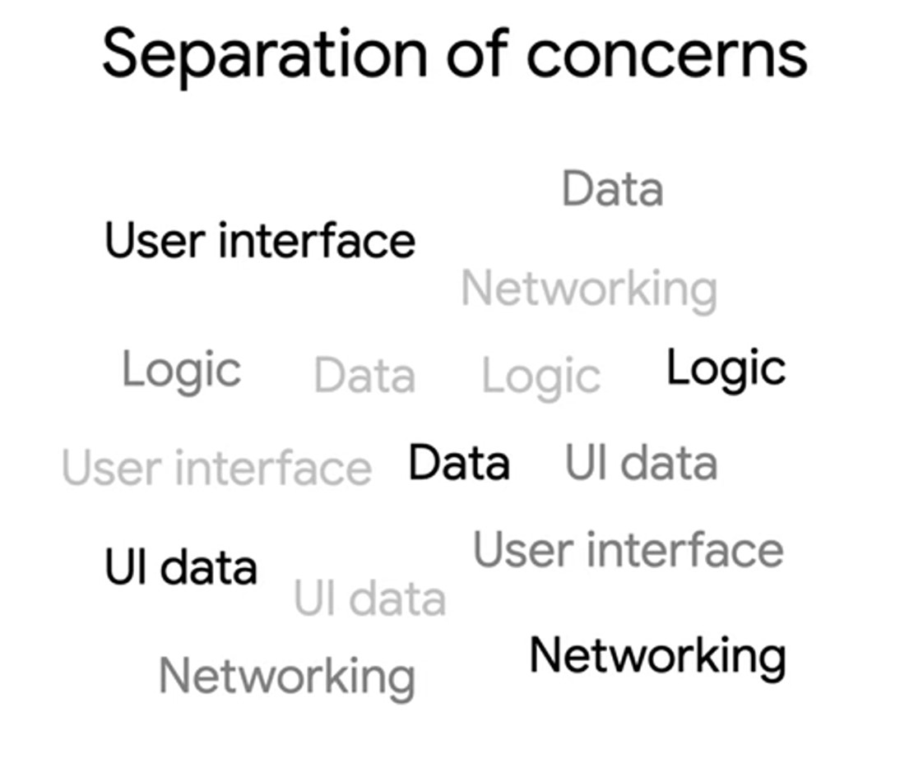

Slide 12
Layered Architecture
UI Layer
Data Layer

Slide 13
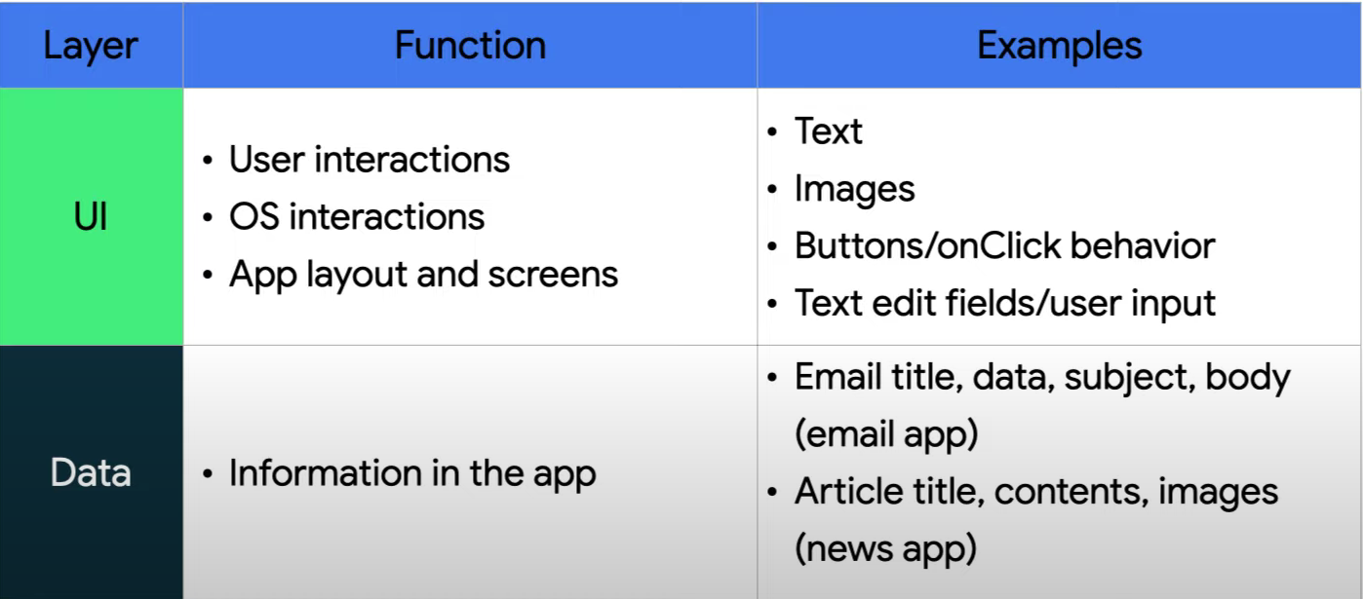
Layered Architecture

Slide 14
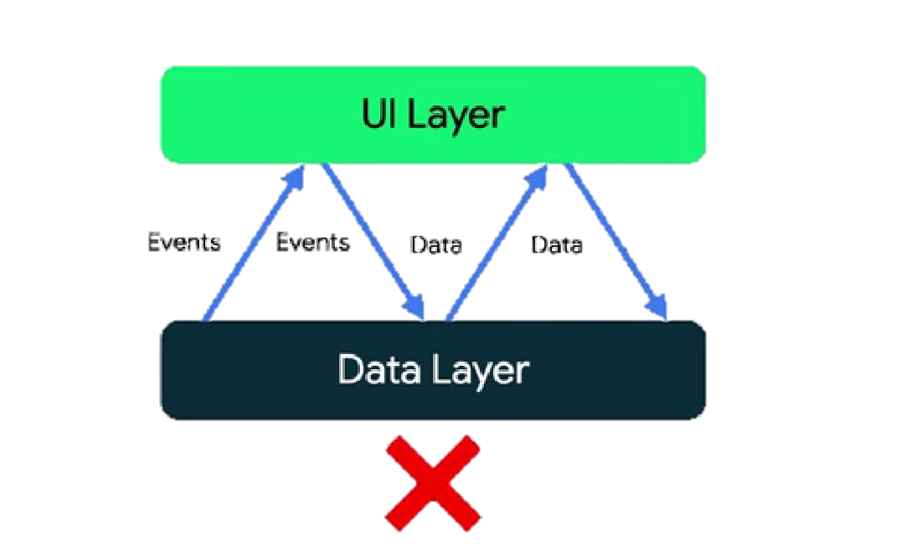
Communication is key

Slide 15
Layered Architecture
UI Layer
Events
Data
Data Layer

Slide 16
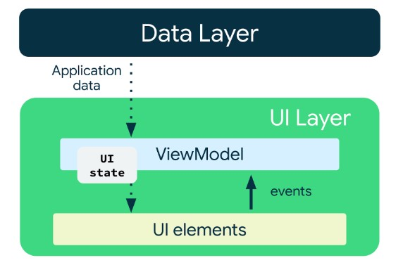
Unidirectional Data Flow
A unidirectional data flow (UDF) is a design pattern in which state flows down and events flow up. By following unidirectional data flow, you can decouple composables that display state in the UI from the parts of your app that store and change state. The UI update loop for an app using unidirectional data flow looks like the following:
Event: Part of the UI generates an event and passes it upward—such as a button click passed to the ViewModel to handle—or an event that is passed from other layers of your app, such as an indication that the user session has expired.
Update state: An event handler might change the state.
Display state: The state holder passes down the state, and the UI displays it.

Slide 17
What is the UI ?
UI Elements
UI State
UI

Slide 18
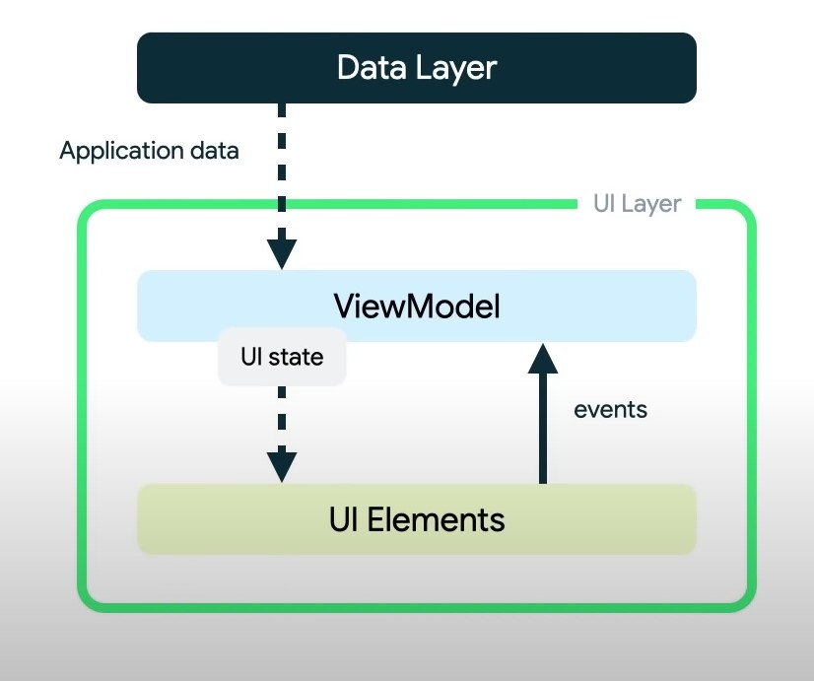
ViewModel and UI Pipeline
ViewModel exposes UI State
UI notifies ViewModel of events
ViewModel updates state and is consumed by the UI
Repeat as necessary

Slide 19
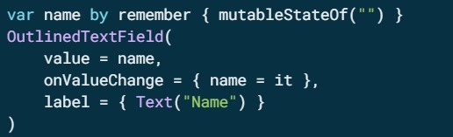
Architecting Compose UI
In Compose, the only way to update the UI is by changing the state of the app. What you can control is the state of your UI. Every time the state of the UI changes, Compose recreates the parts of the UI tree that changed.
Composables can accept state and expose events. For example, a TextField accepts a value and exposes a callback onValueChange that requests the callback handler to change the value because composables accept state and expose events, the unidirectional data flow pattern fits well with Jetpack Compose.

Slide 20
Implementation

Slide 21
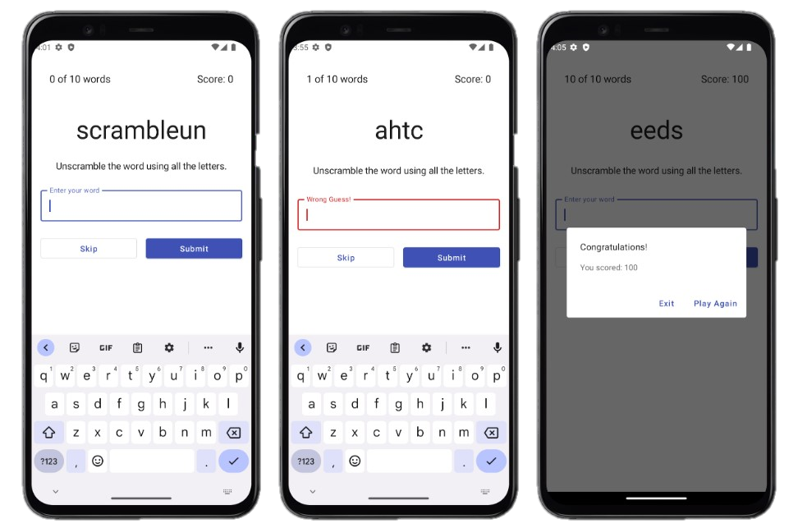
Unscramble App

Slide 22
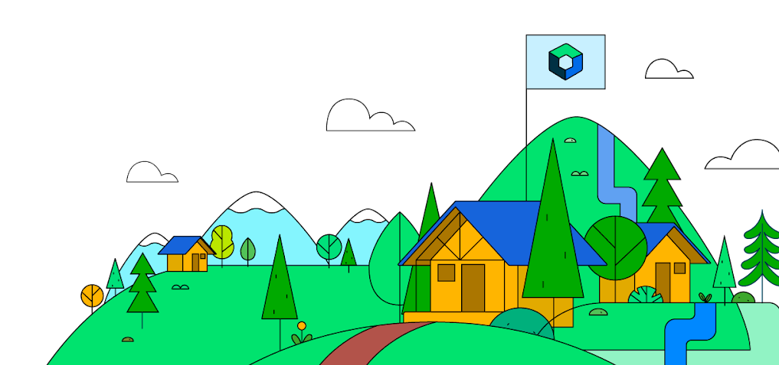
Let’s see the Code!

Slide 23
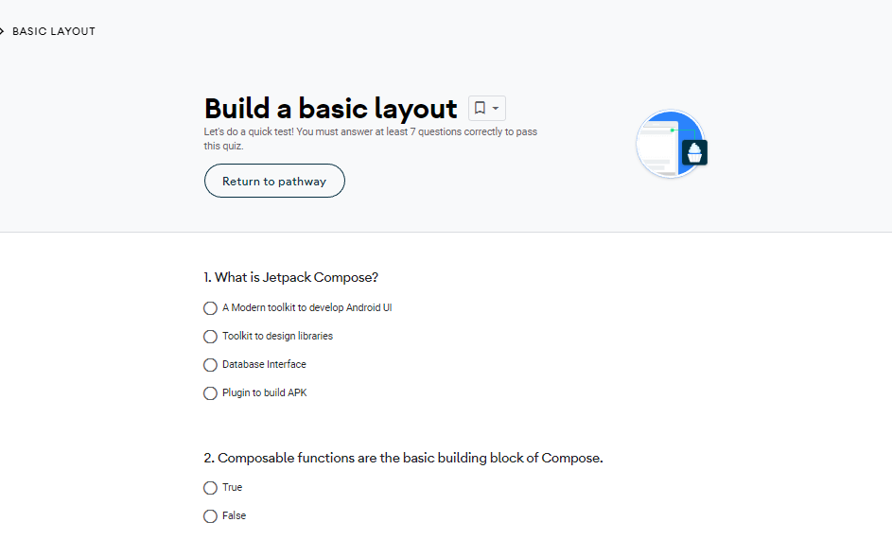
Take a Quiz

Slide 24
Project Submission
College or University App
Clone App
Private or Individual Solution App
An app which could help your fellow students or faculty or college. Some suggestions here could be, Time-table tracking app, Attendance recording app, University transportation tracking app, University navigation app, University database for different departments etc.
Recreate four or more screens of any play store application (with >=50000 downloads) using Jetpack Compose. You can choose to make clones of social media apps, music apps or any other application that is commonly used in your region.
An app that can change an individual’s life or whole business performance. We would encourage you to go to small local business owners e.g. Bakery Shop, Gyms Centers, Restaurant or any other local businesses to understand their business model and identify a problem that can be solved by using an app.

Slide 25
Project Submission
Go through the GDSC India Guidelines
Create App
Create public Github repo
Write an One-Pager Intro
Submission Link :
https://docs.google.com/forms/d/e/1FAIpQLSd8-UvmZvh43MYcrbJ_cvMCN5lY_DSUXR9_DyAQ1890EUxTPg/viewform?usp=sf_link
Submit your Project BY
14th Oct’ 22
Review Your Project
Write an One-Pager Intro

Slide 26
Have a Question? Just ask
Join our Public Discord Server to learn more: http://bit.ly/dsckiitdiscord

Slide 27
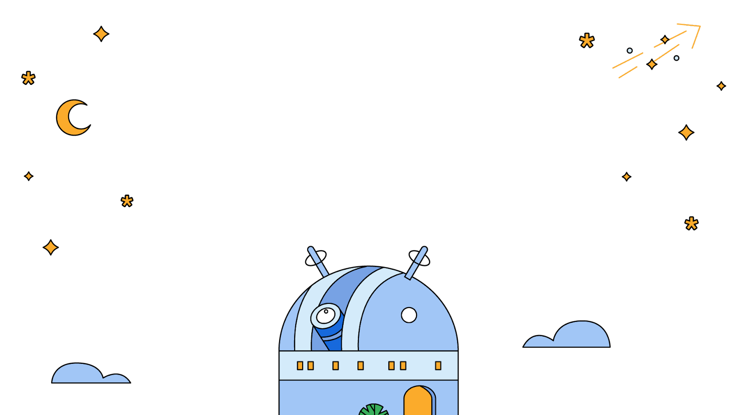
Thank You !!
.

